Slide 1

Analysis of
16S Sequencing Output from Dwiyanto et al, 2021,
“Ethnicity influences the gut microbiota of individuals sharing a geographical location: a cross-sectional study from a middle-income country”
BIOMI6300 Project 2
Luna Eresta Jaya
(Redbus)
Notes:
The Bray-Curtis distance is a commonly used dissimilarity measure in the analysis of microbial communities. It is a type of ecological distance metric that calculates the dissimilarity between two samples based on the relative abundance of the different microbial taxa present in the samples.
The Bray-Curtis distance takes into account the abundance and composition of microbial taxa in each sample, and it is a useful tool for comparing the overall structure of microbial communities across different samples or experimental groups. It is particularly useful in the analysis of microbiome data because microbial communities are often complex and composed of many different taxa, each of which may have different roles in the community.

Slide 2

Background of Data
Johor, Malaysia: a melting pot of culture!
Asian, multi-ethnic, middle-income country
Long-standing history of cohabitation
16S Sequencing of human stool samples from:
46 Malay → 3 analyzed (2 in final figures)
65 Chinese → 3 analyzed (2 in final figures)
49 Indian → 3 analyzed
54 Native → 3 analyzed
Compared diet, lifestyle, medical history
Incomplete metadata available → only habitation (subdistrict) and sex used here
(World Atlas)
Notes:
high-income country, where difference across ethnicity was partly attributable to recent migration events and their incomplete assimilation into the host nation.
Such pragmatic grouping ignored the fact that “Asians” consisted of genetically and culturally diverse communities.

Slide 3
Question and Hypothesis
Question:
Do different ethnicities have different microbiome profiles, after controlling for other demographic factors?
Hypothesis:
Ethnicity exhibited the largest effect size across participants, which is retained after controlling for all other variables
The Chinese ethnic group will have a high proportion of Bifidobacteria, while the Indian ethnic group will have a high proportion of Prevotella

Slide 4
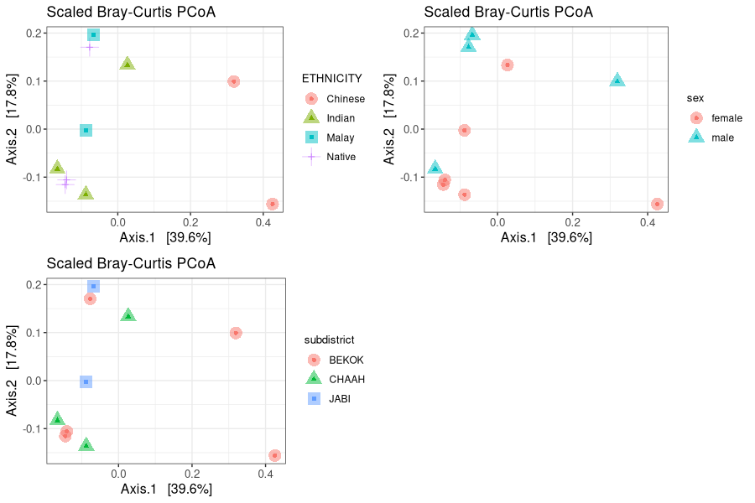
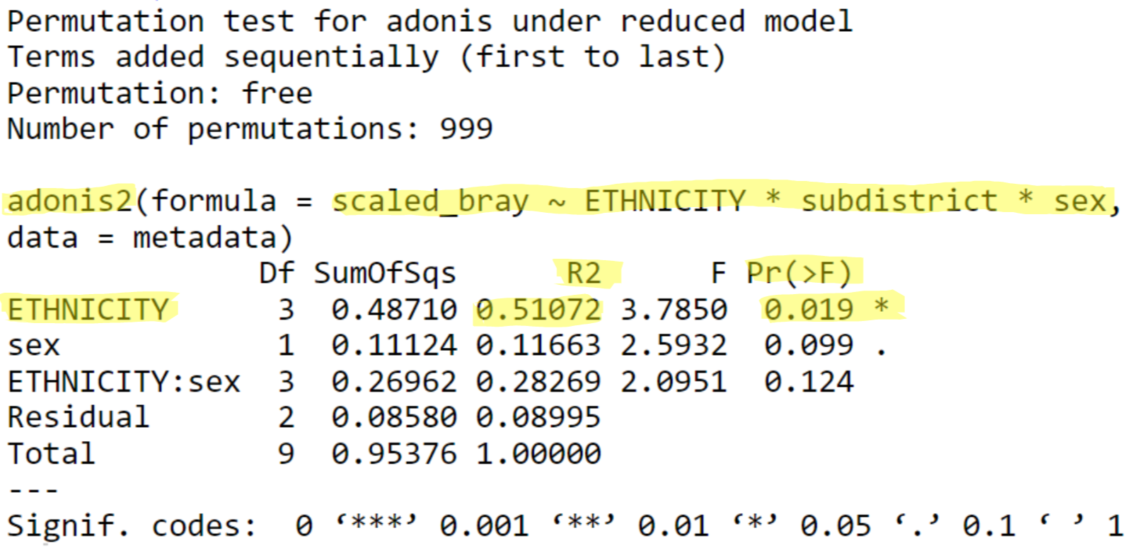
PCoA Plot (Scaled Bray-Curtis)
Separation observed between Chinese vs. others on Axis.1
Sex and Subdistrict points scattered more evenly
Notes:
Based on ~650 seq.
n = 10 (2 Chinese, 3 Indian, 2 Malay, 3 Native)

Slide 5
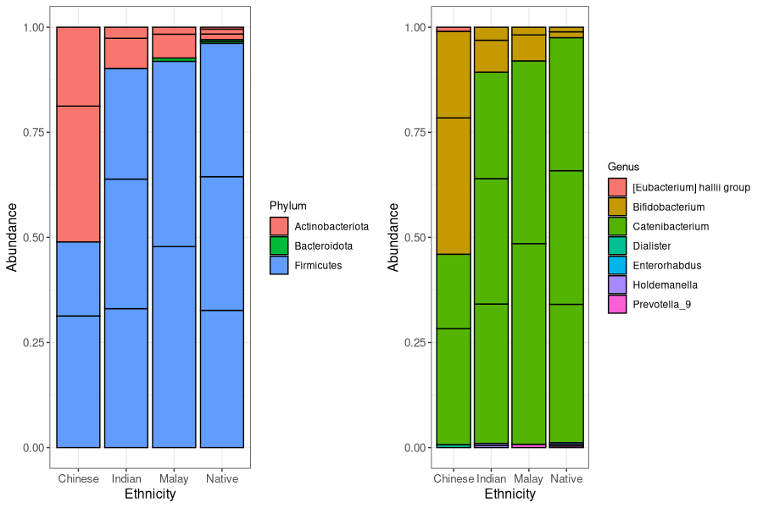
Compositional Analysis
High abundance of Bifidobacterium observed in the Chinese population
Not much Prevotella found in the Indian population
Notes:
Based on ~650 seq.
n = 10 (2 Chinese, 3 Indian, 2 Malay, 3 Native)
Normalized based on sample size
65% of the ASVs did not reach the genus level!

Slide 6
Conclusions
Hypothesis:
Ethnicity exhibited the largest effect size across participants, which is retained after controlling for all other variables
→ Observed, when compared to subdistrict and sex
→ Similar to findings of the paper!
The Chinese ethnic group will have a high proportion of Bifidobacteria, while the Indian ethnic group will have a high proportion of Prevotella
→ Observed for the Chinese group
→ Not observed for the Indian group

Slide 7
References
Dwiyanto, Jacky, et al. “Ethnicity Influences the Gut Microbiota of Individuals Sharing a Geographical Location: A Cross-Sectional Study from a Middle-Income Country.” Scientific Reports, vol. 11, no. 1, 2021, https://doi.org/10.1038/s41598-021-82311-3.
Prasoodanan P. K., Vishnu, et al. “Western and Non-Western Gut Microbiomes Reveal New Roles of Prevotella in Carbohydrate Metabolism and Mouth–Gut Axis.” Npj Biofilms and Microbiomes, vol. 7, no. 1, 2021, https://doi.org/10.1038/s41522-021-00248-x.
Yang, Bo, et al. “Diversity of Gut Microbiota and Bifidobacterial Community of Chinese Subjects of Different Ages and from Different Regions.” Microorganisms, vol. 8, no. 8, 2020, p. 1108., https://doi.org/10.3390/microorganisms8081108.

Slide 8
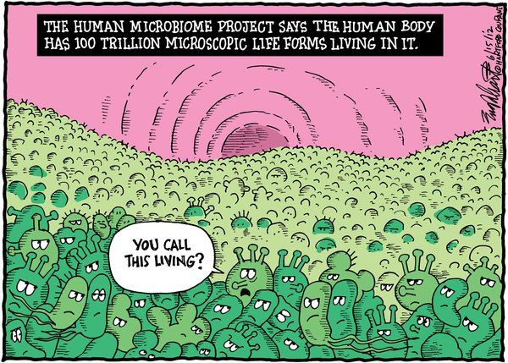
Thank You!

Slide 9
Appendix

Slide 10
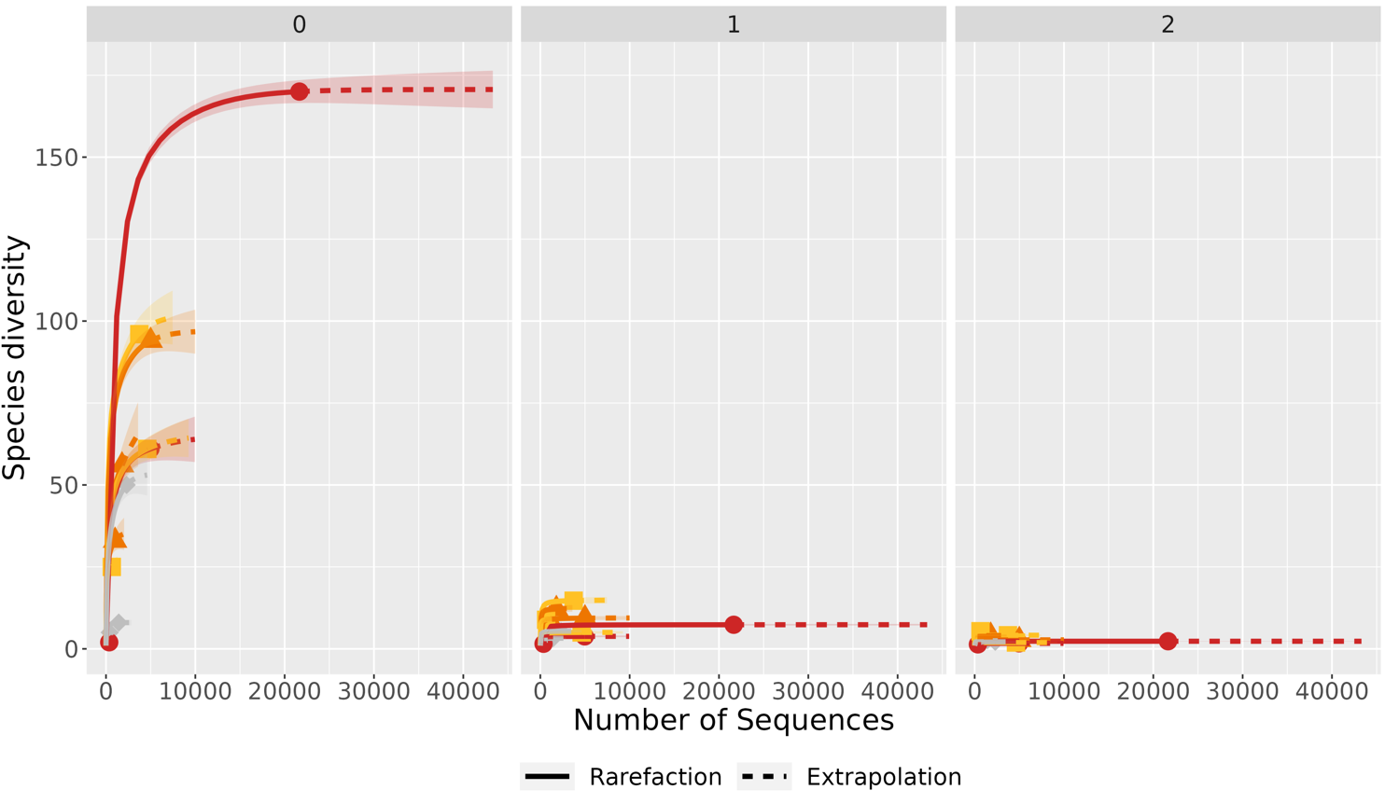
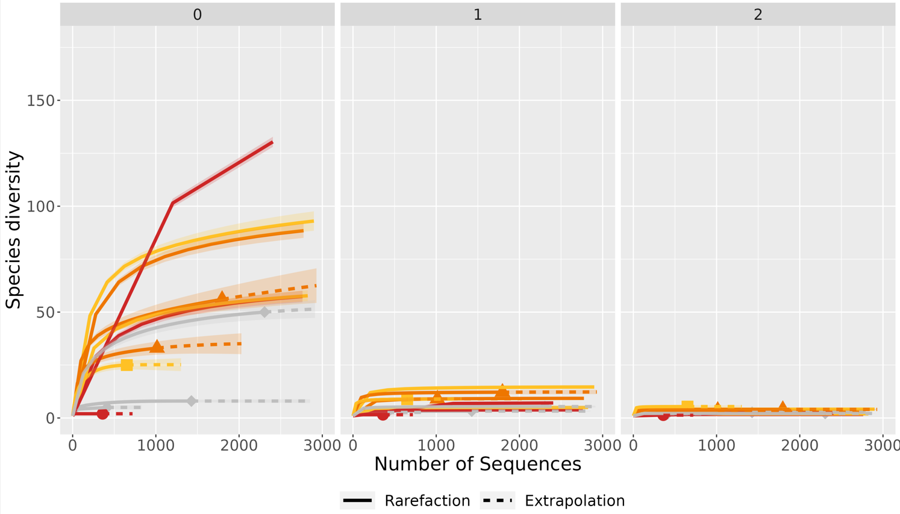
Diversity Boxplots Across Ethnicities (Richness)
Hill q value
Notes:
n = 12 (3 Chinese, 3 Indian, 3 Malay, 3 Native)
2 points below 500 sequences removed in subsequent analysis
Zoomed version of top figure

Slide 11
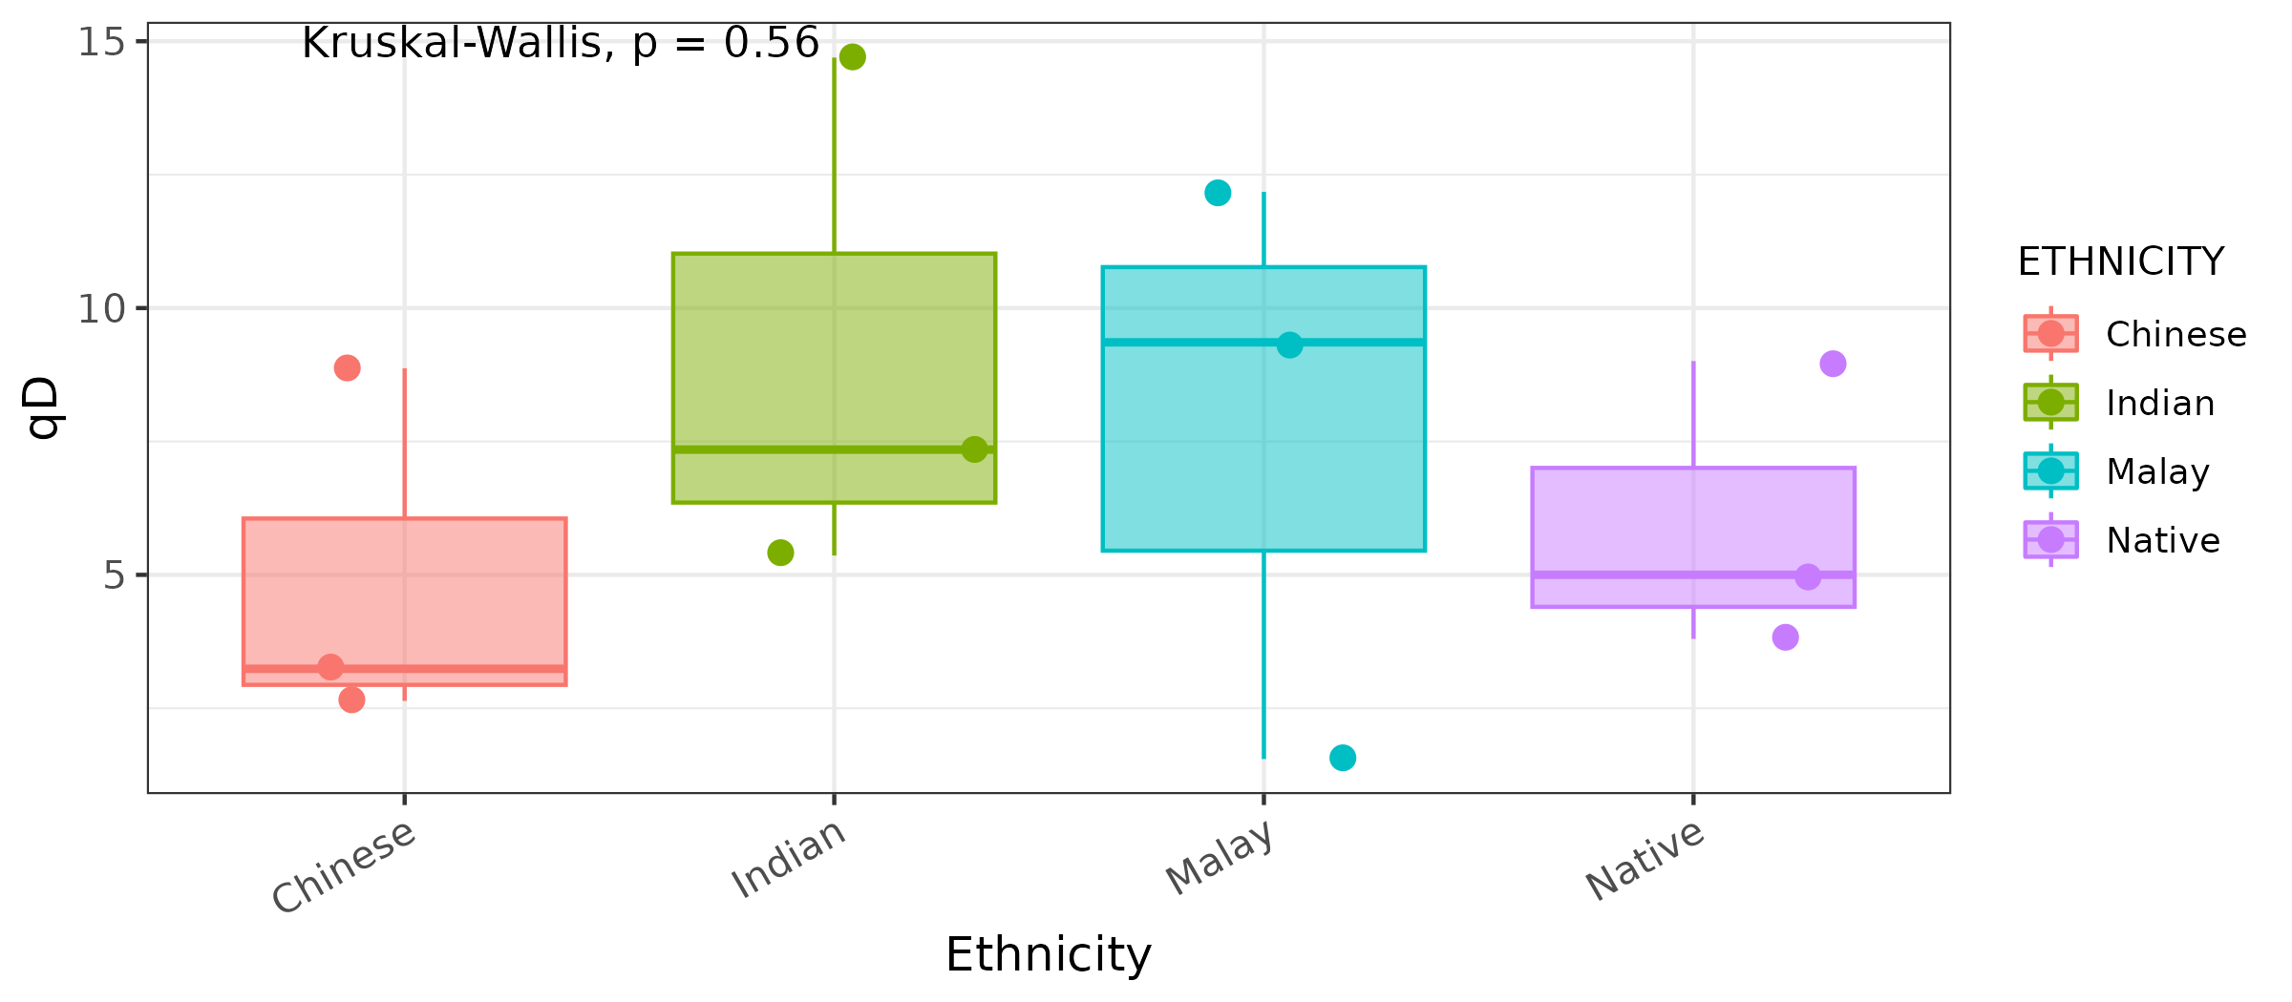
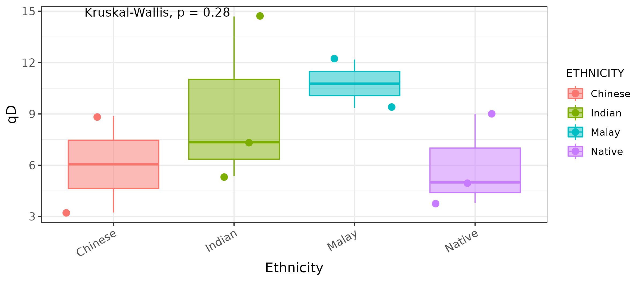
Diversity Boxplots Across Ethnicities (Shannon Index)
Notes:
[Top] n = 12 (3 Chinese, 3 Indian, 3 Malay, 3 Native)
[Bottom] n = 10 (2 Chinese, 3 Indian, 2 Malay, 3 Native)

Slide 12
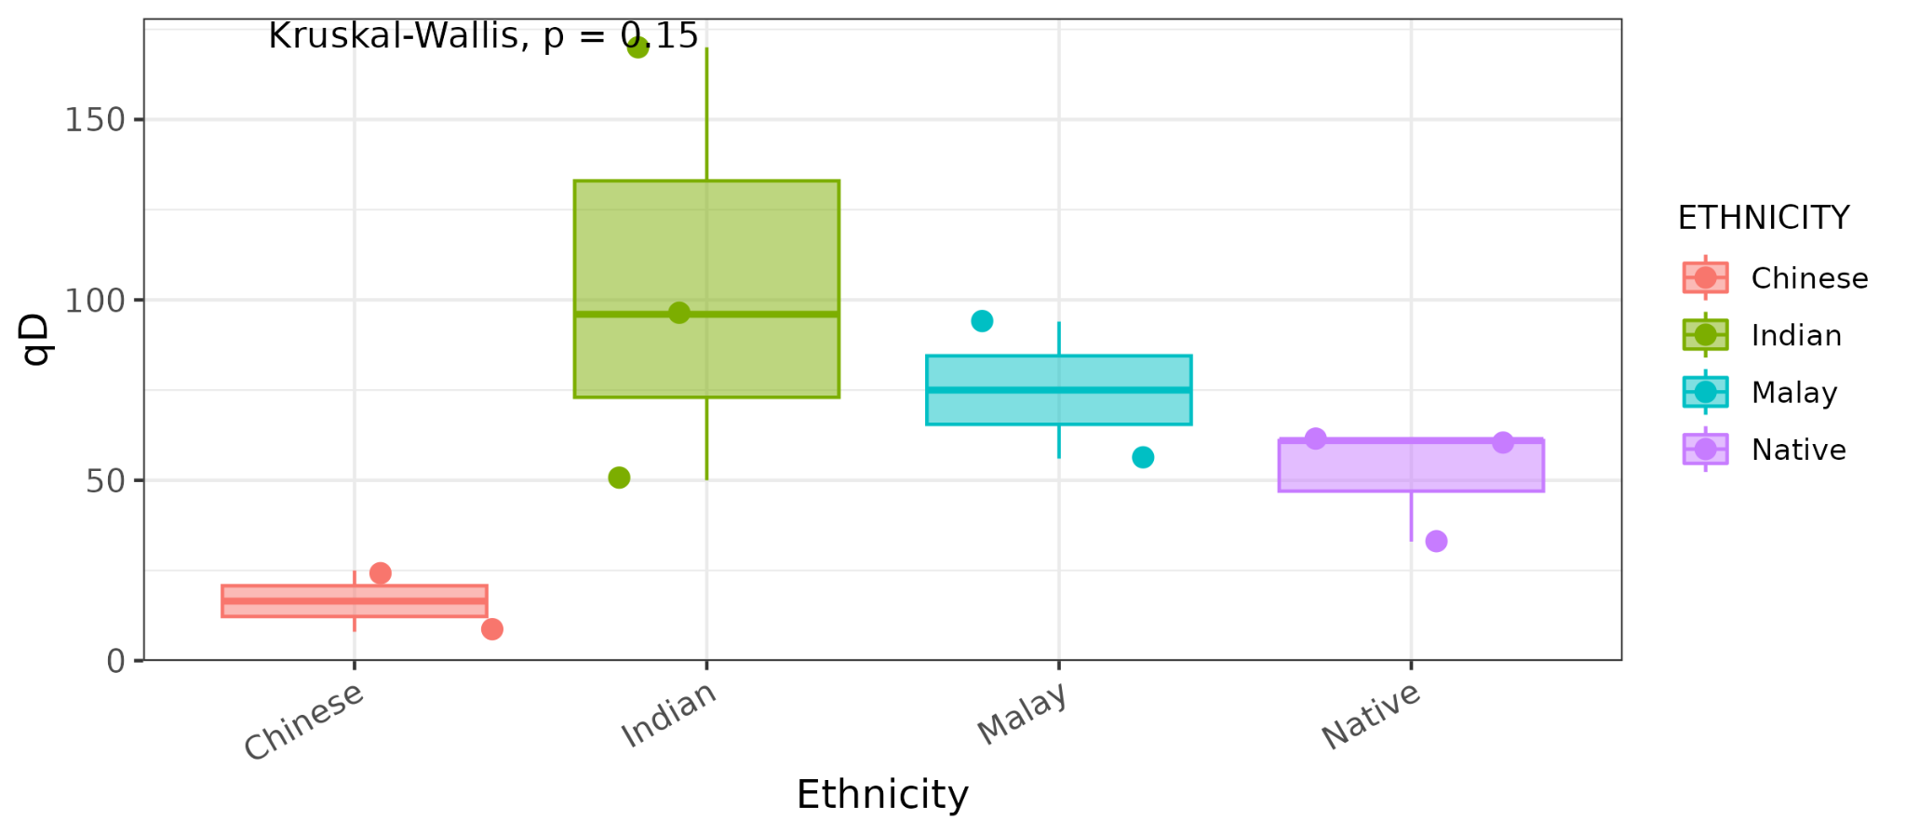
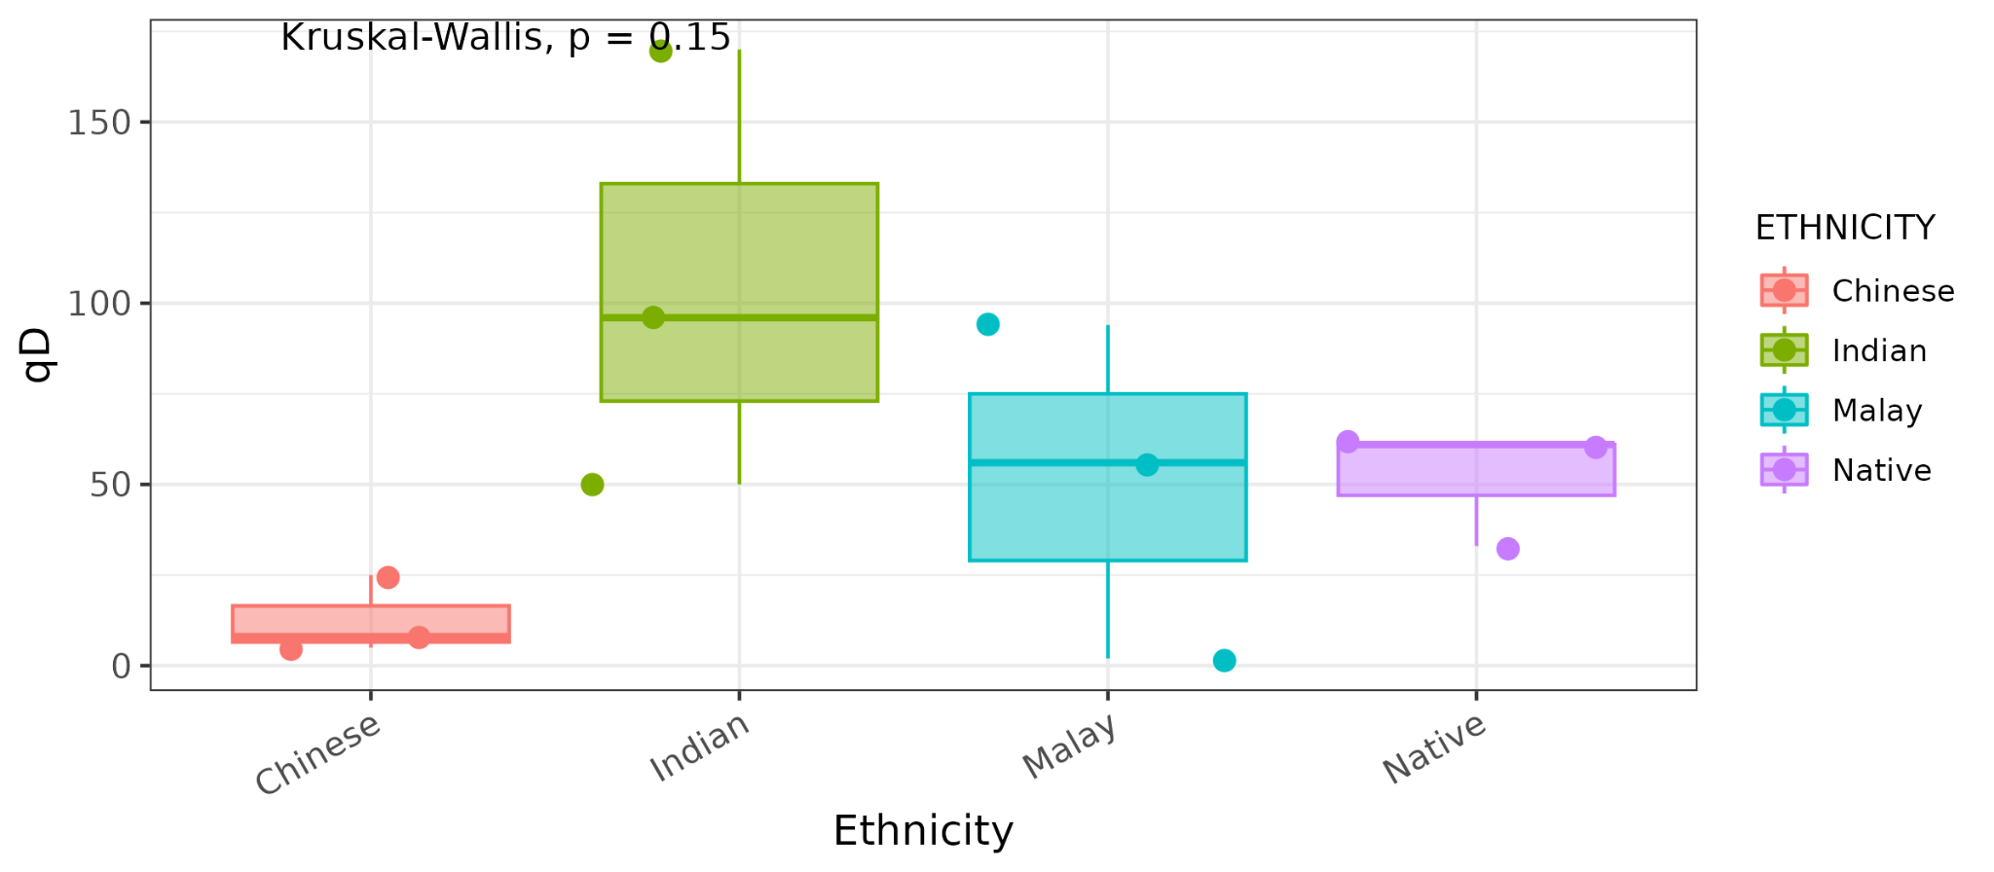
Diversity Boxplots Across Ethnicities (Richness)
Notes:
[Top] n = 12 (3 Chinese, 3 Indian, 3 Malay, 3 Native)
[Bottom] n = 10 (2 Chinese, 3 Indian, 2 Malay, 3 Native)

Slide 13


